Slide 1
Pneumococcal Disease Cases
Dr Chinedu Nwokoro
MB BChir MRCPCH

Slide 2
Case 1 - RP
2.5 yr ♀
7/7 cough
4/7 unwell
    T = 41.5C
    Oliguria
    Resp distress
Recent travel to Indonesia

Slide 3
Examination
Looks unwell
Right otitis media
Pulse 140
RR 68
O2 sats 95% in air
Urine 2+ protein
Decreased AE right chest

Slide 4
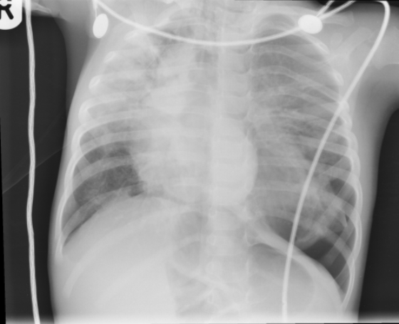
Investigations?
Bloods
  CRP 270
  FBC, Urea and electrolytes normal
CXR

Slide 5
Treatment?
IV abx (IV penicillin, oral clarithromycin)
IV fluids (2/3 maintenance)
Oxygen
BC grew Strep pneumoniae

Slide 6
Day 2 - Deterioration
Grunting
Tachypnoea
↑O2 requirement
Dull percussion – thoughts?
Physiotherapy → improved oxygenation
Ultrasound???

Slide 7
Day 3 - Deterioration
Pallor, jaundice and bruising
Lethargy
Resp distress and agitation
Splenomegaly
Anuria, diarrhoea, facial oedema
Hypertension (BP 122/83)
What do you do now?

Slide 8
Thoughts?
Repeat Bloods:
  Hb 4.5
  Plts 27
  Na 125
  K 4.9
  BIC 14
  urea 32.8
  Cr 228
  APTT 60.8
  Fib 9.7
  ALT 107
  Alb 22
Pneumococcal
Haemolytic Uraemic Syndrome (HUS)

Slide 9
Treatment
Haematology/Renal advice
Fluid restriction (30ml/kg/day, strict balance)
Hourly blood pressure
Bicarbonate infusion
Blood transfusion (with frusemide cover)
Midazolam for agitation

Slide 10
Day 4 - Deterioration
Pulmonary oedema
Gallop rhythm
Hepatomegaly
Elective ventilation (4/7)
Transfer for haemofiltration on Renal ICU
5/7 HF, 15/7 HD, 11/7 PD

Slide 11
Pneumococcal HUS
Diarrhoea negative HUS (diff pathology)
Pneumococcus produces neuraminidase → endothelial damage by stripping N-acetyneuraminic acid from cell surface
Exposes T antigen on rbcs, plts, glomeruli
Circulating Anti-T Ig → haemolysis, thrombocytopenia, renal failure, DIC
Notes:
In cases of HUS caused by Streptococcus pneumoniae, the bacteria produce neuraminidase, which damages endothelial cells. The bacteria remove N- acetylneuraminic acid from cell-surface glycoproteins and expose the normally hidden T antigen (Thomsen-Friedenreich antigen) on erythrocytes, platelets, and glomeruli. Serum has anti-T immunoglobulin M (IgM), which can react with the antigen and cause damage to red blood cells and the kidneys.
The causes of D⁺ HUS and D⁻ HUS differ.
Diarrhea-associated hemolytic-uremic syndrome
Gastrointestinal tract infection with STEC precedes most cases of typical D⁺ HUS. Stx1 is identical to the Stx produced by Shigella dysenteriae. Stx2 has a 55-60% amino acid homology with Stx. They injure the gut and lead to hemorrhagic colitis. The majority of cases worldwide are associated with STEC 0157:H7 infection. This organism is very resilient; active disease has been reported in environments up to 10 months following initial contamination. Aside from Stx production, this bacteria produces virulence genes that mediate tight adherence to the host cell, facilitating transluminal transport of the toxins into the systemic circulation. Cattle are the major reservoir for human infection. The use of antimotility agents, antidiarrheal agents, and antibiotics has been reported to increase the risk of developing HUS.
Other causes of HUS include infection by the following:
S dysenteriae (established as an etiologic agent)
Salmonella typhi (established as an etiologic agent)
Campylobacter jejuni (established as an etiologic agent)
Yersinia species
Pseudomonas species
Bacteroides species
Entamoeba histolytica
Aeromonas hydrophilia
Organisms of the class Microtatobiotes
Non-diarrhea–associated hemolytic-uremic syndrome
Inherited (autosomal dominant or recessive), eg, mutations in the gene for factor H (a complement regulatory protein)
S pneumoniae (neuraminidase associated)
Portillo virus
Coxsackie virus
Influenza virus
Epstein-Barr virus
Vaccines (eg, mumps; measles; smallpox; polio; diphtheria, pertussis, tetanus [DPT])
Pregnancy
Drugs (eg, chemotherapy, oral contraceptives)
Bone marrow transplantation
Malignancy
Idiopathic
Systemic lupus erythematosus (SLE)
Glomerulonephritis
Malignant hypertension

Slide 12
Case 2 - DS
4m ♀ presents unwell
  Fever 39ºC
  Vomiting
  High pitched unconsolable cry
  Poor feeding
  Full fontanelle
Thoughts?
Notes:
A 4-month-old female infant was admitted to a local hospital with fever, vomiting, excessive crying, and not tolerating feeding. The case of the patient was investigated with lumbar puncture. Cerebrospinal fluid analysis revealed a cell count of 53/µL with 56% polymorphonuclear leukocytes and low cerebrospinal fluid glucose (20 mg %) and normal protein levels. Pyogenic meningitis was diagnosed (culture report Streptococcus pneumoniae), and the patient received antibiotics for 5 days. As the infant became afebrile, the treatment was discontinued. At that time, the isolate was sensitive to ceftriaxone, and the infant received antibiotics accordingly. Five days after this, she again started to have high fever and developed convulsions. The patient was referred to our hospital, and at the time of admission, she was febrile (temperature, 39°C); head circumference was 44 cm (larger than normal). The anterior fontanel was open, slightly tense but pulsatile. General physical examination found no other abnormalities. The infant was drowsy and irritable. Neurologically, the child was moving all 4 limbs equally, and there was no facial asymmetry. Laboratory tests revealed a peripheral white blood cell count of 11,700/µL, with normal urinalysis results and blood chemistry profile. Repeat lumbar puncture was not carried out, and the administration of antibiotics (intravenous injection ceftriaxone, 100 mg/kg per day in 2 divided doses) was continued as per the previous reports. Seizures were controlled with anticonvulsants. An emergency computed tomography (CT) of the brain was performed, and it showed thin hypodense collection over the left frontotemporoparietal convexity region with diffuse cerebral edema (Figs. 1A, B). A diagnosis of postpyogenic meningitis subdural effusion was suspected, and the patient continued to be prescribed with antibiotics. The infant continued to have fever, and there was increase in the size of head circumference. Anterior fontanel became further tense and nonpulsatile. The infant developed decerebrate posturing and became further dull with convergent squint. A subsequent CT scan showed increase in the size of subdural collection and appearance of multiple new collections (Figs. 1C, D). The collections were tapped and were hemorrhagic and showed S. pneumonia sensitive to ceftriaxone, amikacin, and vancomycin but showed resistance to penicillin. Antibiotics were changed, and the patient was continued on intravenous injection ceftriaxone (100 mg/kg per day in 2 divided doses). Because of the severity of the infection, intravenous injection vancomycin (60 mg/kg per day was added), and the treatment was continued for a total duration of 2 weeks. Although gradually the decerebrate posturing disappeared, the patient became afebrile, head circumference was reduced, anterior fontanel became lax, and she was tolerating foods but was still not active.
Figure 1The incidence of subdural empyema was from 10% to 20% in all childhood intracranial bacterial infections 5; in young children, subdural empyema usually develops as a complication of bacterial meningitis.5,6 As in the present case and in a series,4 all postmeningitis subdural empyemas have been described as cerebral convexity collections, usually bilateral, and in all cases, culture grew S. pneumonia. Usually, these lesions can be detected within 2 to 5 days of symptom onset; however, there may be delay of up to 3 weeks.4 For large pyogenic collections in the subdural space, an aggressive surgical drainage at an early stage of disease with concomitant long-term administration of antibiotics is recommended.7 In the present case, large subdural empyema complicated the course of partially treated meningitis (when the child initially became afebrile, the antibiotic treatment was discontinued). This case illustrates that complete and adequate treatment of meningitis with adequate doses of antibiotics for recommended duration (intravenous injection ceftriaxone 100 mg/kg per day and intravenous injection vancomycin 60 mg/kg per day for a period of 10-14 days)8-12should be carried out to avoid disabling as well as life-threatening sequela of meningitis.

Slide 13
Investigations
Lumbar Puncture:
  1100 wbc/μl
  56% neutrophil predominance
  Low CSF glucose < 20% serum glucose
  Normal protein
  Gram positive cocci in chains
Presumptive dx pneumococcal meningitis →
Culture pneumococcus sens CTX

Slide 14
Further Progress
D5 IV Ceftriaxone stopped as afebrile
(– n.b. It is usual to treat for 10-14 days)
D10 - new fever and convulsions,
- ↑ OFC
- Tense, pulsatile fontanelle
- Drowsy, irritable
- Moving all limbs (nil focal)

Slide 15
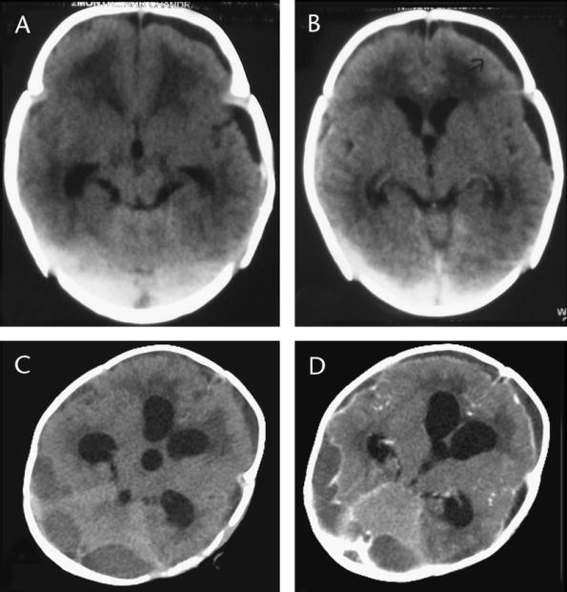
What to do Now?
IV phenobarbitone for seizures
Restart antibiotics with/without repeat LP???
Emergency CT was performed
Left frontotemporal lucent collection
Cerebral oedema

Slide 16
Deterioration
Persistent fever
↑H.C. and drowsiness
Decerebrate posturing
Convergent squint
Fontanelle → non-pulsatile
Repeat CT with contrast
Outcome
Collections drained, haemorrhagic, grew pneumococci – sens CTX, res penicillin
Vancomycin IV added for additional 2/52 - fever resolved, fontanelle decompressed
Infant tolerated foods but did not recover normal function

Slide 17
Errors in This Case
Short duration of therapy (10-14 days for pneumococcal meningitis)
Should receive 0.15mg/kg dexamethasone QDS for 4/7 as soon as possible and ideally within 4 hrs of 1st dose of antibiotics
Aggressive early drainage may have been helpful

Slide 18
Subdural Empyema
Subdural empyema accounts for up to 20% of childhood intracranial bacterial infections
In young children it is 2ary to meningitis (usually pneumococcal – poorest prognosis)
In older children it may be 2ary to sinusitis in which case other organisms may be implicated
Notes:
1The incidence of subdural empyema was from 10% to 20% in all childhood intracranial bacterial infections 5; in young children, subdural empyema usually develops as a complication of bacterial meningitis.5,6 As in the present case and in a series,4 all postmeningitis subdural empyemas have been described as cerebral convexity collections, usually bilateral, and in all cases, culture grew S. pneumonia. Usually, these lesions can be detected within 2 to 5 days of symptom onset; however, there may be delay of up to 3 weeks.4 For large pyogenic collections in the subdural space, an aggressive surgical drainage at an early stage of disease with concomitant long-term administration of antibiotics is recommended.7 In the present case, large subdural empyema complicated the course of partially treated meningitis (when the child initially became afebrile, the antibiotic treatment was discontinued). This case illustrates that complete and adequate treatment of meningitis with adequate doses of antibiotics for recommended duration (intravenous injection ceftriaxone 100 mg/kg per day and intravenous injection vancomycin 60 mg/kg per day for a period of 10-14 days)8-12should be carried out to avoid disabling as well as life-threatening sequela of meningitis.

Slide 19
Case 3 - JB
4 year old ♂
4/7 vomiting
Fever > 39C
Severe right sided abdominal pain
????
Referred to paediatric surgeons with suspected appendicitis

Slide 20
Paediatric History and Exam
2/7 laryngitis preceding vomiting
Anorexia but good fluid intake
Mucoid vomitus associated with wet cough 6/7
Decreased air entry right lower quadrant
Pulse 120, RR 28, O2 sats 95%, CRT < 2s
????
Discharged with 7d oral amoxicillin

Slide 21
Represented D5
Fever persists despite amoxicillin
Now not drinking, vomiting antibiotics
SOB, dry lips
O2 sats 89%
No tracheal deviation, dull right chest
???
CXR, Oxygen

Slide 22
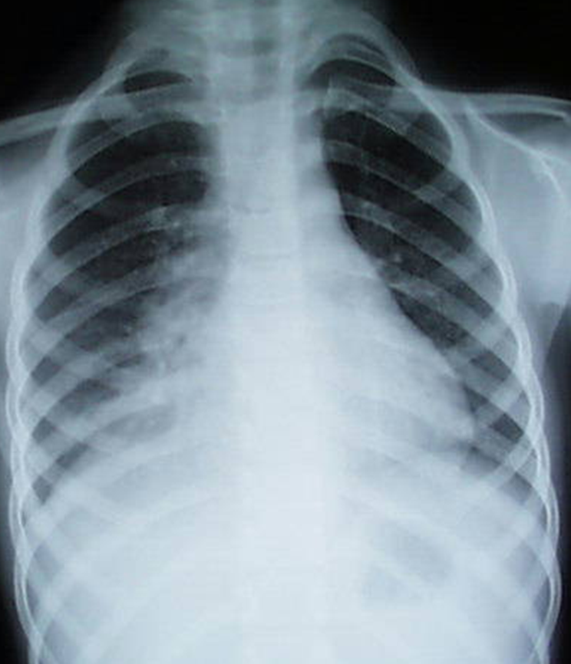
Chest X-ray
What now????
Oxygen to keep sats >90%
IV antibiotics
(penetration, culture results)
IV /NG rehydration
Discharge when tolerating oral abx, feeds, no O2 req, fever settling

Slide 23
Follow-up
Hospital f/u not usually required, unless
  Complicated pneumonia (sepsis, effusion, abscess)
  Atypical X-ray (round pneumonia, collapse) - may require repeat imaging at 8-12 weeks to → resolution
  Persistent symptoms? Consider TB, immunodeficiency, foreign body, CF?

