Slide 1
Preschool Wheezing:
Phenotypes and Therapies
Dr Chinedu Nwokoro
Lung in Childhood
8th March 2016

Slide 2
Contents
What is preschool wheeze?
How can it be classified?
Therapeutic options?
Research Questions?

Slide 3
What is Preschool Wheeze?
What is wheeze?
    High pitched whistling
    Expiration
    Associated dyspnoea
    Clinicians vs parents perceptions
Age group
    Bronchiolitis vs PSW vs asthma
Incidence
    26% of ALSPAC cohort wheezed before 18m

Slide 4
Why Do We Care?
Commonest paediatric presentation
    1 in 3 children wheeze before 3rd birthday
Optimal treatment is unclear
    Steroids harmful (Ducharme), ineffective (Grigg)
    Bronchodilators difficult to administer/don’t prevent admission
    LTRAs variably effective (Preempt, Valovirta)
    Maintenance therapy if normal inbetween?

Slide 5
Why Phenotype?
A label?
Prognosis
    Individual patient
    Resource allocation
Investigation
Therapy
Research (define populations, targets)

Slide 6
Classification Schemata
Epidemiological
Pathophysiologic
Symptom pattern
Therapeutic response phenotype
Genetics – severity and treatment

Slide 7
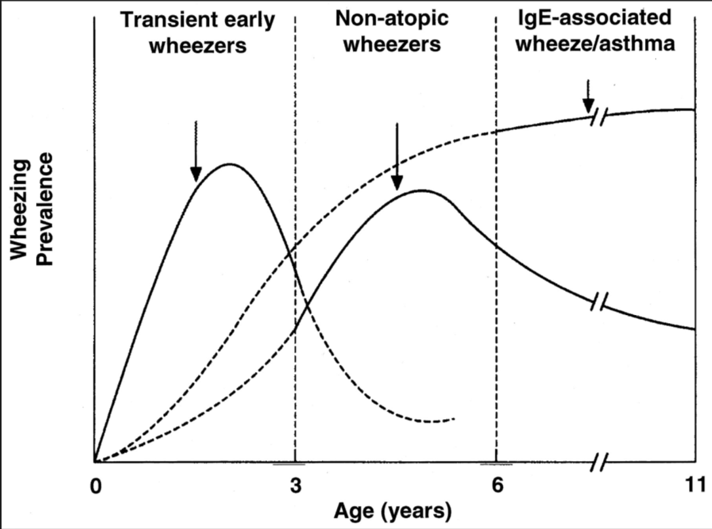
Epidemiologic - Tucson
(Early low LF, mat ETS, non-atopic)
(Late Onset)
(Persistent)
Notes:
Transient = commence before age of 3 and end by 6
Persistent = continue beyind 6 years (asthma/IgE assoc wheeze)
Late onset = start after 3 (non-atopic wheeze)
Tucson
Retrospective
Why phenotype
How can we use it to guide research, therapy, prognosticate?
Does it map to other classifications.

Slide 8
Pathophysiologic - Atopy
Asthma Predictive Index (API)
    If at age <3 a recurrent wheezer has:
              or
    Increased likelihood of “doctor-diagnosed asthma” beyond 6y (PPV 77%, NPV 97%)
  1 major criterion
  Parental asthma
  Eczema
  2 minor criteria
  >4% Eosinophilia
  Aeroallergen sensitisation
  Non-viral wheezing
Notes:
3 episodes per year
Can reassure parents but can’t confirm
Can’t guide treatment

Slide 9
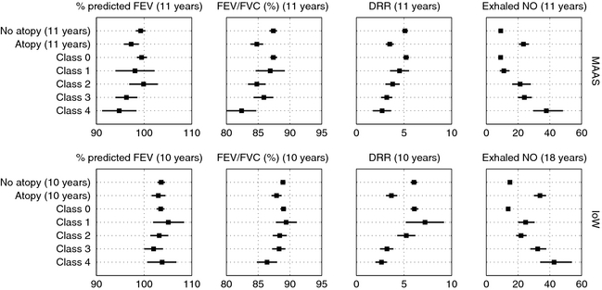
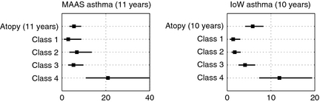
Pathophysiologic - Atopy
MAAS/IOW Cohorts – Lazic et al. Allergy ‘2013
Serial IgE (1,3,5,8y) and SPT (1,3,5,8,11y)
IOW – SPT only ( 3 ages)

Slide 10
Pathophysiologic - Histology
Endobronchial biopsy
Safe - not routinely practicable – data limited
Older children/adults – remodelling, eosinophilia
O’Reilly et al. – preschool ASM → school age asthma
Malmstrom et al.
  RBM thickness, mucosal mast cells assoc c preschool symptoms, but...
  Did not predict asthma at age 8

Slide 11
Pathophysiologic – Airway fluid
BAL or IS
  IS increasingly practicable in very young
  Microbiology, cytological, inflammatory mediators, transcriptome
  But………
IS cellularity ≠ BAL cellularity (Jochmann et al.)
Airway cellularity ≠ longitudinally stable (Fleming et al.)
BAL cellularity does not effectively guide rx in children (Fleming et al.)

Slide 12
Pathophysiologic – Eθ inflamm
FeNO assoc w remodelling in preschoolers (Sonnappa)
FeNO-modified API predicts school age asthma (Singer)
  Impracticable in younger preschoolers
  Doesn’t guide rx in school-aged children
ECP/EPX – Eθ degranulation: don’t predict rx response
IgE – contributes to predicting asthma (Smit et al. 2015)
Peripheral Eθ form part of API
  Prognostication
  Can’t guide treatment

Slide 13
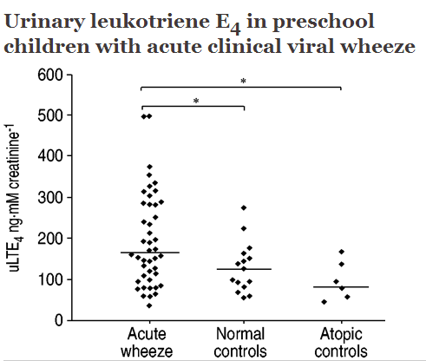
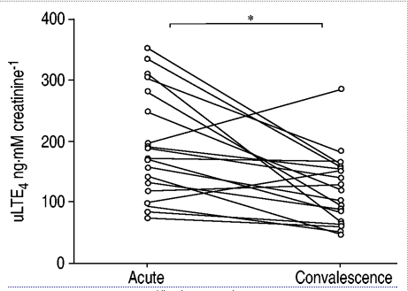
Pathophysiologic – Other biomarkers
Eicosanoids – AA breakdown products
  elevated in BAL of PSW (Krawiec et al.)
  Measurable in urine, BAL, IS, EBC
LTE₄
  incr in acute PSW (Oommen et al, Maimarinos et al)
  Inhalation causes bronchospasm in adults
  Elevated in exercise induced asthma
  uLTE₄:FeNO ratio → LTRA response in older (Rabinovitch)
  LTRA variable evidence in PSW (Robertson, Valovirta)

Slide 14
Clinical – Symptom Pattern
2008 ERS Task force (Brand et al.)
  EVW – discrete viral episodes – suggest MTL as 1st line preventer
  MTW – wheeze between URTIs – suggest ICS as 1st line preventer (PEAK study – ICS → decr exac in PSW with high API cf placebo)
API incorporates presence of MTW
Symptom pattern problems
  Not stable
  Subjective
  Retrospective

Slide 15
Clinical – Treatment Response
Many reasons for rx failure
  Compliance, technique, misdiagnosis, comorbidity
No standout acute, preventative, disease-modifying rx
Consensus/extrapolation > strong evidence
Key agents:
  Steroids, LTRA, Anticholinergic, Beta₂ agonists
  (Macrolides???)
Poor evidence due to group/response heterogeneity?
Notes:
Compliance
Technique
Diagnosis

Slide 16
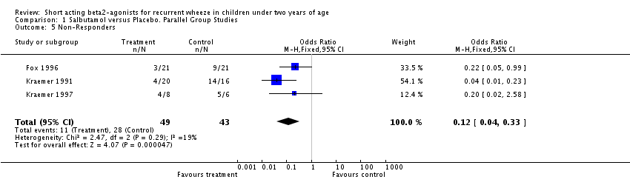
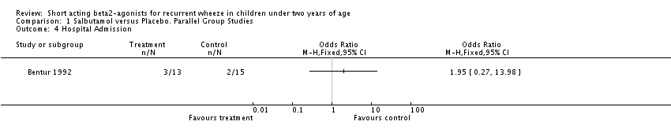
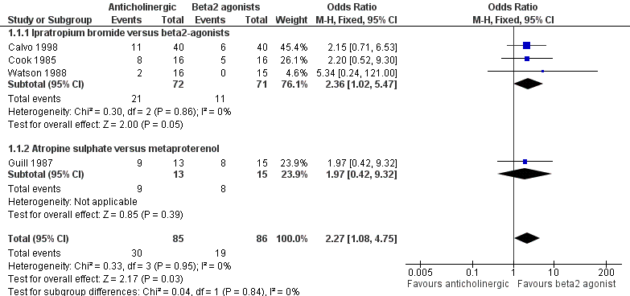
Therapy – Beta₂ agonist - SABA
Rapid onset, duration up to 6hrs
SM relaxation via ADRB2
2008 Cochrane review → no evidence in under 2s

Slide 17
Therapy – Beta₂ agonist - SABA
Heterogeneity of response
Arg16Gly (Tucson) SNP in ADRB2
Stat SABA
  Arg16 → incr response (5.3x for Arg:Arg) cf Gly:Gly
  Varying polarity of response depending on ethnic group/study
Chronic SABA
  Arg 16 → decr FEV1, incr exacerbation rate cf Gly:Gly
?Arg16 → incr baseline [ADRB2] but incr downregulation
??SABA overuse drives rather than reflects poor control??

Slide 18
Therapy – Beta₂ agonist - LABA
Not licensed in this age, no evidence base
Arg16 associates with enhanced downregulation
LABA associated with death when used in isolation
  ?Need antinflammatory steroid effect
  upregulation of ADRB2 by ICS
Allele frequencies (De Paiva et al.)
  Asthmatic - Arg16 = 0.53, Gln27 =0.67
  non-asthmatic - Arg16 = 0.27, Gln27 = 0.33

Slide 19
Therapy – Anticholinergic
Block muscarinic AChR → decr mucus/SM contraction
Evidence of efficacy but less effective than SABA
Evidence of synergy with SABA
Combined preparations vs “burst”
Safe

Slide 20
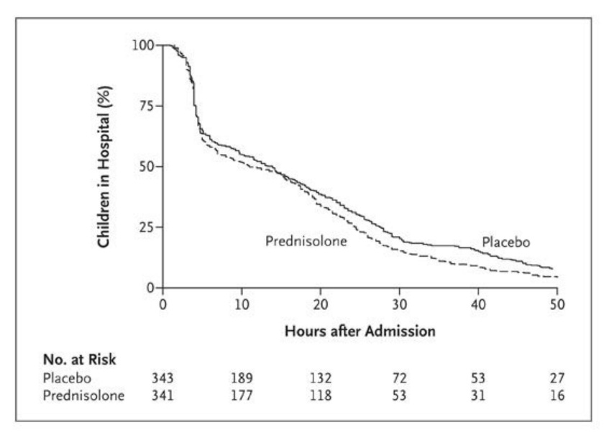
Therapy – PO corticosteroids
Binds cytoplasmic GC receptors, dimerizes → nucleus
  Inhibits inflammatory gene expression/cell activity
  Upregulates ADRB2 expression
  Augments cAMP response to Beta agonist (potentiates SABA)
PO prednisolone ineffective in preschool viral wheeze
  No impact on LOS, sympts, or risk of admission (Oommen, Panickar)
ICS indicated in troublesome PSW (Kaiser et al. 2016)
FCER2 SNP assoc w ⬆exac, USMA, ⬇FEV1 with ICS
Notes:
T2206

Slide 21
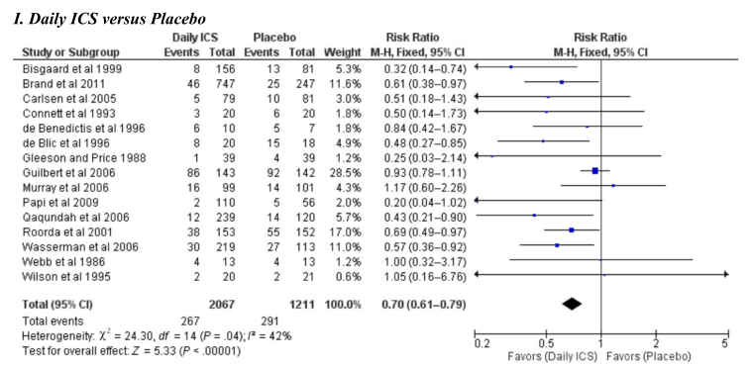
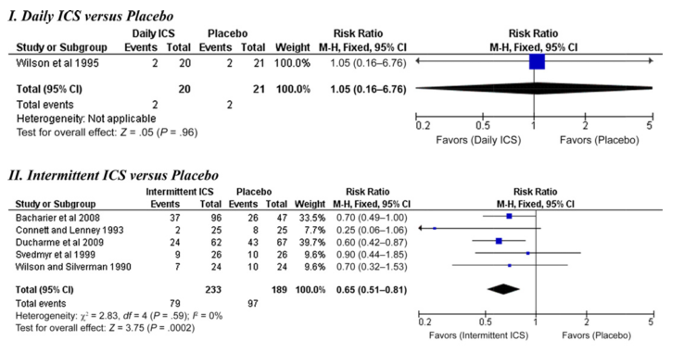
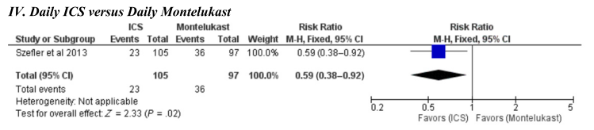
Therapy – Inh corticosteroids
Notes:
T2206

Slide 22
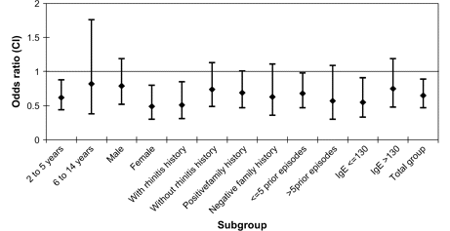
Therapy – LTRA
Montelukast only agent licensed in children
Inhibit cys-LT action at cys-LTR1/2 (and maybe GPR99)
  Reduced SMA contraction and mucus secretion
  Cys-LTs excreted via urine
Inconsistent trial data…
Preempt – intermittent MTL 2-14y
Reduced USMA in 2-5y subgroup
Notes:
T2206

Slide 23
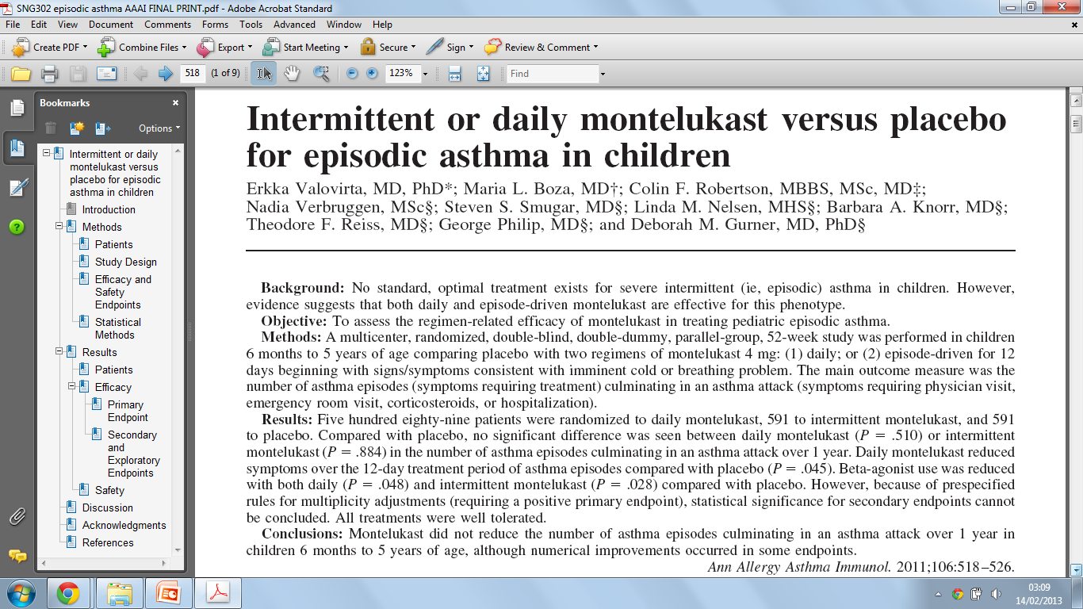
Therapy - LTRA

Slide 24

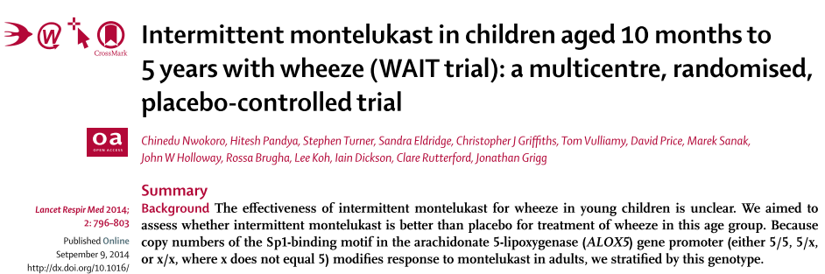
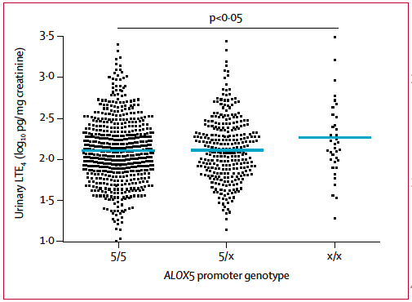
Therapy - LTRA
Mechanistic corroboration?
 | Montelukast |  | Placebo |  | IRR | Significance
USMA | 2.0 | + 2.6 | 2.3 | + 2.7 | 0.88 | P = 0.06
USMA (5/5) | 2.0 | + 2.7 | 2.4 | + 3.0 | 0.80 | P = 0.01
USMA (5/X + X/X) | 2.0 | + 2.5 | 2.0 | + 2.3 | 1.03 | P = 0.79
 |  |  |  |  | P(interaction) = 0.08

Slide 25
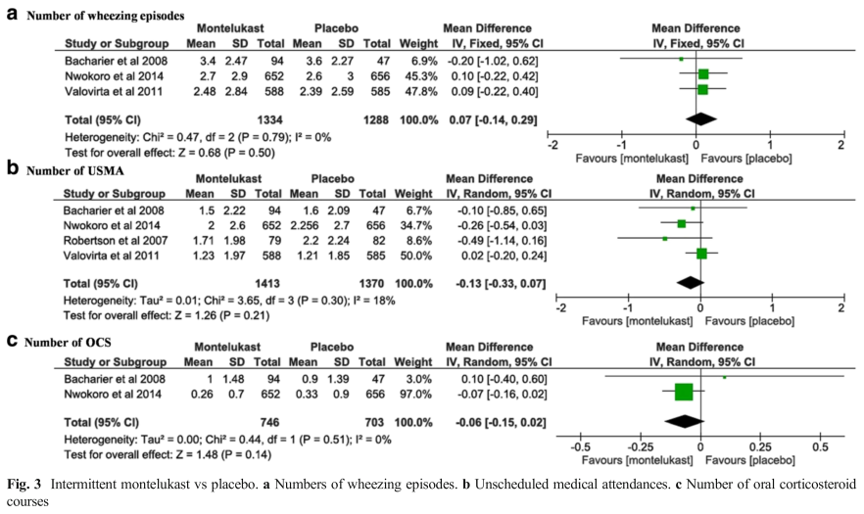
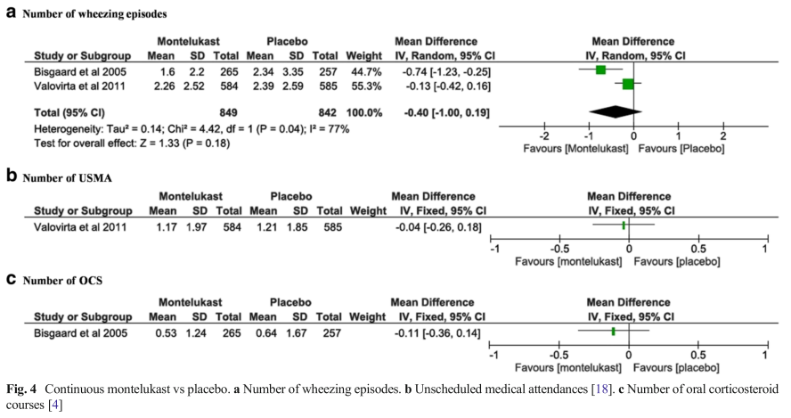
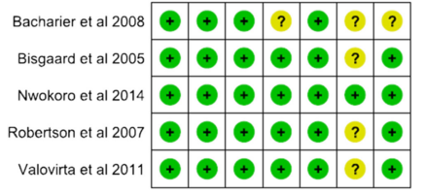
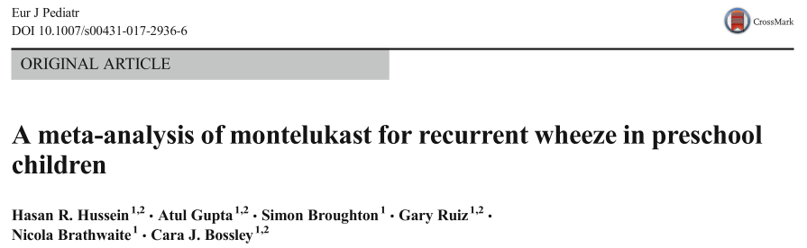
Therapy – LTRA
Summary
Overall no evidence of efficacy
Suggestion of genetically divergent response
  Lima et al. (ALOX5 5/x + x/y – better response - adults)
  Nwokoro et al. (ALOX5 5/5 – ?better response – PSW, not stat sig)
Suggestion of montelukast bias in over 2s
  Preempt - Robertson, Previa – Bisgaard (2-5y)
  compare Valovirta (6m-5y), Nwokoro (10m-5y)
Notes:
T2206

Slide 26
Summary Recommendation
PRN SABA
Maintenance low dose ICS (1st line)
Structured trial LTRA (up to 3m, 2nd line)
If successful, discontinue and observe, (consider intermittent LTRA if sx recur)
Intermittent ICS for intermittent sx?

Slide 27
Research Questions
How can we predict:
  Treatment response?
  Symptom persistence?
Are there genetically determined treatment responsive subgroups? (steroids, LTRAs)
Role of PgD2 inhibition?
Can we prevent progression to asthma?

