Slide 1
Ventilation in Pneumococcal Disease
Dr Chinedu Nwokoro
MB BChir MRCPCH

Slide 2
Synopsis
Goals and Indications
Modalities and equipment
Ventilatory Strategies
Monitoring and weaning
Complications
Post-ventilation care
Notes:
<5 mortality reducing 1990-2010 88/1000 live births to 57 (35%)
Incr rate of decline 2.1% per year 1990-2010 to 2.6% pa 2005-2010
50% child deaths occur in WHO African Region rate of decline incr from 1.8-2.8

Slide 3
Goals and Indications
Why provide ventilatory support?
Respiratory failure (or impending)
  Hypoxic (Type I)
  Hypercapnic (Type II)
“The inability of the respiratory system to meet the metabolic demands of the body through adequate gas exchange”

Slide 4
Goals of Ventilation
Achieve and maintain adequate pulmonary gas exchange (blood gases, O₂ saturations)
Minimize the risk of lung injury
Reduce patient work of breathing
Optimize patient comfort

Slide 5
Signs of Respiratory Compromise
O2 saturations less then 90% (if available)
Central cyanosis
Paradoxical breathing
Chest recessions
Tachypnoea
Wheeze (or silent chest)
Grunting/Gasping
Age | RR
<2m | >60/minute
2-11m | >50/minute
1-5y | >40/minute

Slide 6
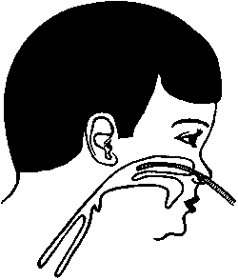
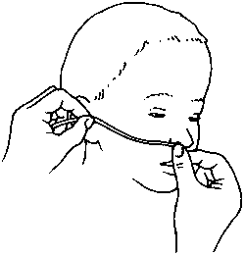
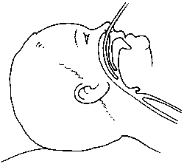
Ventilatory Optimisation - Airway
Nasal – nasal saline, nasal prong, nasogastric tube (pros/cons), nasopharyngeal airway
Oral – oropharyngeal airway, airway manoeuvres (resus)

Slide 7
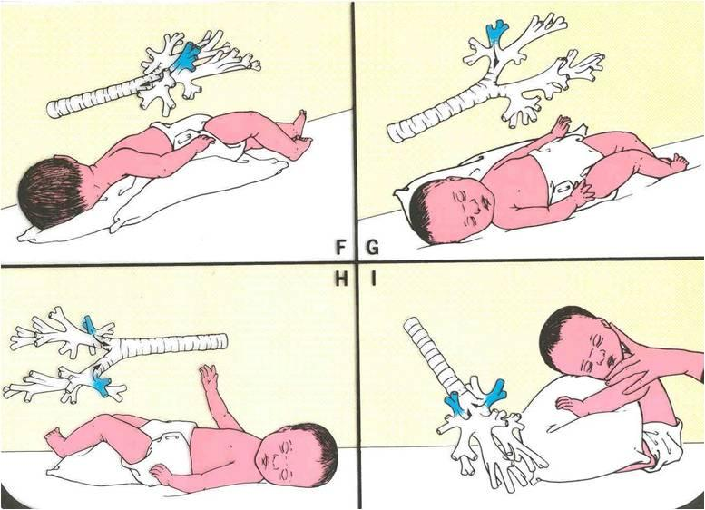
Ventilatory Optimisation - Physio
Prone positioning – may improve ventilation
Position affected lobe uppermost
Encourage cough
Percussion
Phys activity

Slide 8
Ventilatory Optimisation - Drugs
Bronchodilators
Adrenaline
Steroids
Nebulised saline
  Being trialled in bronchiolitis (SABRE)
Mucolytics
  May aid reexpansion of atelectatic lobe

Slide 9
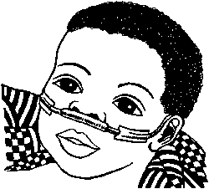
Oxygen Delivery
Nasal prongs/catheter:
  0.5-2l/min → 30-35% FiO₂
  No humidification required
  Nasal catheter (from nares to medial eyebrow)
Nasopharyngeal catheter:
  1-2l/min → 45-60% FiO₂ (xs → gastric distension)
  Humidification required
  Nares to tragus of the ear

Slide 10
Indications for Ventilatory Support
Airway compromise
  ↓ consciousness
  Refractory airway oedema
Impending fatigue
  Grunting, XS work of breathing
  Silent chest, gasping
  Rising CO2, refractory hypoxia
Disease specific
  Status epilepticus
  Sepsis
Age 2
HR 150
RR 70
O2 sat 89%
pH = 7.25
pCO2 = 7.9
pO2 = 10
B.E. = -6
HCO₃⁻ = 17.0

Slide 11
Non-invasive Ventilation - 1
CPAP
  Conscious – may need sedation in small babies
  Delivers constant airway distending pressure
  Reduces opening pressure required per breath
  Can be delivered via nasal airway/mask/prongs
BiPAP
  Bilevel pressure (EPIP and IPAP),
  IPAP triggered by pt → synchronise
  Can deliver a set minimum rate and FiO₂
Negative Pressure Ventilation

Slide 12
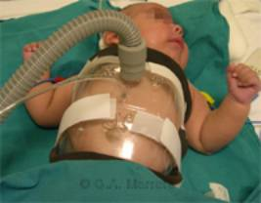
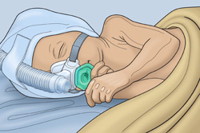
Non-invasive Ventilation - 2

Slide 13
Mechanical Ventilation - Kit
Ventilator
Oxygen supply
Endotracheal tube and laryngoscope
Suction catheter
End-tidal CO₂ monitoring/blood gas monitor
Physiotherapist/nurse
Sedative drugs

Slide 14
Mechanic Ventilation Modes
Mainly SIMV or Control
Controlled modes | SIMV (synchronized intermittent mandatory ventilation)
Every breath supported | Ventilator synchs with pt effort
Can’t wean by rate reduction | Pt takes own breaths (+/- ρ-support)
Pt may hyperventilate if agitated | Can have incr WOB (if inadequate PS)
Risk of pt-vent asynchrony → need for sedation/paralysis | Asynchrony possible but less likely

Slide 15
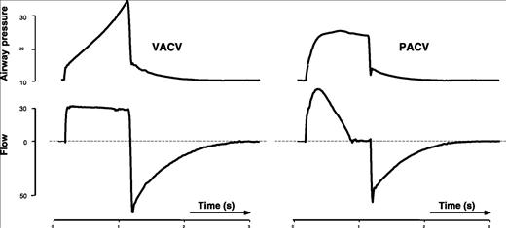
Volume vs Pressure Limitation
Support is limited by pressure or volume
Pressure-limited | Volume-limited
Preset PIP and PEEP | Preset tidal volume
Volume/flow varies with compliance | Pressure varies with compliance
Babies/Infants < 6-8kg | Children > 8-10kg
Can have pressure support (PS) for patient-triggered breaths (set trigger and PS) | Constant insp flow, variable pressure

Slide 16
Ventilator Settings
FIO2 - fraction of inspired oxygen
Rate - number of breaths per minute
Tidal Volume - volume of each breath
Sensitivity - how responsive the ventilator is to the patient’s efforts
PIP : maximum amount of pressured delivered during each breath
PS: pressure support delivered in assisted breaths (a weaning mode)
Inspiratory Time (I time)- the time spent in the inspiratory phase of the ventilatory cycle
I:E Ratio - the inspiratory time compared to the expiratory time; I + E = total cycle time
PEEP: positive end expiratory pressure

Slide 17
Settings – Pressure vs Volume
Pressure-controlled | Volume-controlled (ρ-limited)
FiO2 | FiO2
Rate (via T_{e}) | Rate (via T_{e})
Peak Inspiratory Pressure (PIP) | Tidal Volume (V_{t})
Positive End Expiratory Pressure (PEEP) | Positive End Expiratory Pressure (PEEP)
Inspiratory Time (T_{i}) | Inspiratory Time (T_{i})
Increase Oxygenation | Increase Ventilation (CO2 clearance)
Increase FiO2 | Increase Rate (RR)
Increase Mean Airway Pressure (MAP) | Increase Tidal Volume (Vt)
MAP = AUC (Pressure vs time) | Minute Ventilation = Vt x RR
Increase (PIP, PEEP, I:E ratio) | Increase ∆PIP-PEEP

Slide 18
Opening Settings
Setting | Range
Rate | Rate – start physiological 15/min – (older child/adolescent) 20-30/min (infant/small child)
FiO2 | 100% and wean
PEEP | 3-5 cm H₂O
PIP | 14-20 cm H₂O
T_{i} | 0.5-1 seconds (i:e ~ 1:2, increase to 1:3 etc if risk of air trapping)
I:E Ratio | 1:2 to 1:4 (varies with Ti and rate) (lower ratios improve oxygenation, higher ratios in asthma)
V_{t} | 7-10ml/kg

Slide 19
Monitoring
General
  Chest movement, synchrony, cyanosis, heart rate
Oxygenation
  Spontaneous resp rate/work of breathing (unparalysed)
  O2 saturation, blood gases
Ventilation
  ETCO2
  Percutaneous Capnography
  Blood gases

Slide 20
Ventilator-associated Pneumonia
Colonisation of the ETT with aerogastric organisms
Translocation of organisms during suction
Fever
Hypoxaemia
Purulent tracheal secretions
Positive tracheal/BAL culture (Ps A, Klebsiella, Serratia, MRSA etc.)

Slide 21
Ventilator-associated Pneumonia
Prevention
  Hand hygiene
  Equipment hygiene, Closed circuit /in-line suction
  Frequent microbial surveillance (isolate pts w MDR-organisms)
  Limit ventilation duration (use NIV, wean early)
  ↓ aspiration (cuffed ETT, H2 blockade, 30º tilt, ↓GI dist)
Treatment
  Physio
  Empirical antibiotics (e.g. Cipro/Vanc)
  Culture-guided antibiotics

Slide 22
Weaning
Is the cause of ventilation improving?
  Improving compliance
  Improving gas exchange
Is the patient well oxygenated and ventilated?
  O2 sats, Blood gases, cyanosis, EtCO2
Can the patient tolerate the increase work?
  Reducing heart rate
  Reducing spont rate, recession

Slide 23
Extubation
Airway safe
  Stop feeds 4 hours prior/empty stomach
  Is the airway patent (leak around the ETT, steroids?)
  Airway reflexes present
  Patient “awake” – sedation stopped
  Suction secretions
Ventilatory requirement minimal
  Minimal oxygen requirement (FiO2 < 25%)
  Minimal rate
  Minimal pressure support (0-10cmH₂O)

Slide 24
Post-Extubation Care
Do not feed orally until well awake and airway safe
Continuous O2 monitoring
Monitor for respiratory distress/stridor
Post-extubation blood gas (1-2 hrs)
Post-extubation CXR if indicated
May be extubated to CPAP/BiPAP/O2

Slide 25
Summary
Aim of ventilation should be optimise oxygenation and ventilation without causing undue damage
Ventilation can be avoided in many circumstances by early recognition of respiratory compromise/use of NIV

Slide 26
MCQ - 1
The following are primary aims of mechanical ventilation – true or false?
A - Improvement of gas exchange
B - Reduction of work of breathing
C - Treatment of pneumococcal disease
D - Improving patient comfort
E - Protection of the airway

Slide 27
MCQ - 2
True or False – Ventilator-associated pneumonia
A - May present with purulent ETT secretions
B - May be prevented by hand hygiene
C - Is most commonly pneumococcal
D - Is restricted to the immunocompromised
E - Does not require treatment

Slide 28
MCQ - 3
True or false - Oxygenation may be increased by:
A - Increasing FiO2
B - Increasing the inspiratory time
C - Increasing the ventilatory rate
D - The use of a nasal airway
E - Increasing the PIP

Slide 29
MCQ - 4
True or false – The following are signs of respiratory compromise:
A - Cyanosis
B - Grunting
C - Chest recessions
D - Fever
E - Stridor

Slide 30
MCQ - 5
True or false – Regarding non-invasive ventilation
A - CPAP may prevent the need for intubation
B - There is a lower risk of secondary infection
C - It may be delivered by nose or by mask
D - It may be useful in bronchiolitis
E - It does not improve oxygenation

Slide 31
Answers
1 TTTTF
2 TTFFF
3 TTFTT
4 TTTFT
5 TTTTF

