Slide 1
Health Education to prevent Pneumonia
Dr Chinedu Nwokoro
MB BChir MRCPCH

Slide 2
Synopsis
The Scale of the problem
  The need for education
Potential impact
Education Targets
  Risk factors
  Target population
Notes:
<5 mortality reducing 1990-2010 88/1000 live births to 57 (35%)
Incr rate of decline 2.1% per year 1990-2010 to 2.6% pa 2005-2010
50% child deaths occur in WHO African Region rate of decline incr from 1.8-2.8

Slide 3
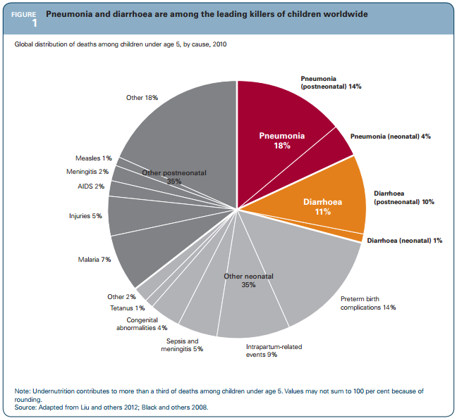
The Scale of the Problem
18% global U5MR
1.2m deaths/year
Pneum interventions could ↓U5MR 17%
(Niessen et al., 2009, WHO bulletin)
Education must target modifiable risks

Slide 4
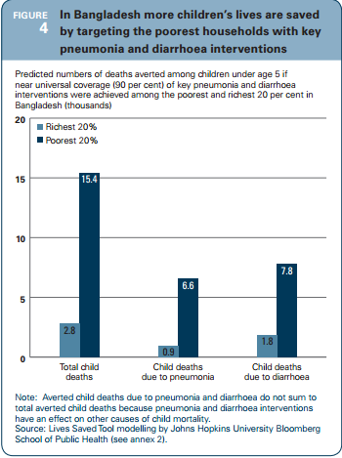
Education + Modifiable Risk Factors
Intervention success is limited by resource but also by population awareness
Education programmes should be targeted and optimised for maximal effect
UNICEF Communications Framework For New Vaccines and Child Survival
Nutrition
Immunisation
Comorbidity
Air Pollution
Domestic Hygiene

Slide 5
Nutrition
Maternal
  Premature birth/LBW
  Maternal/child perinatal morbidity
Exclusive breastfeeding
  At least 6m
  Humoral and innate immunity
Micronutrient supplementation
  Zn, Vit A

Slide 6
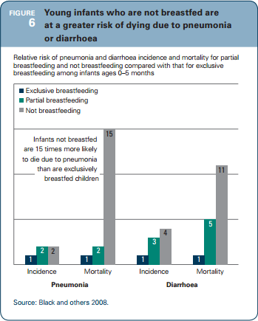
Nutrition - Breastfeeding
RR of pneumonia morbidity
and...
RR of pneumonia mortality
Are reduced by partial and exclusive breastfeeding
Also limits diarrhoea
Cost-effective

Slide 7
Immunisation
Direct
  HiB
  PCV
Indirect
  Pertussis
  Measles

Slide 8
Comorbidity
Diarrhoeal disease
  Causes poor nutrition
  Reduces immunity
  Common preventative strategies
HIV prevalence
  Concomitant HIV increases all-cause morbidity and mortality
Notes:
Childhood diseases are synergistic

Slide 9
Air Pollution
Indoor biomass cooking
  Dung
  Wood
Environmental tobacco smoke
  Cigarettes
  Shisha smoke

Slide 10
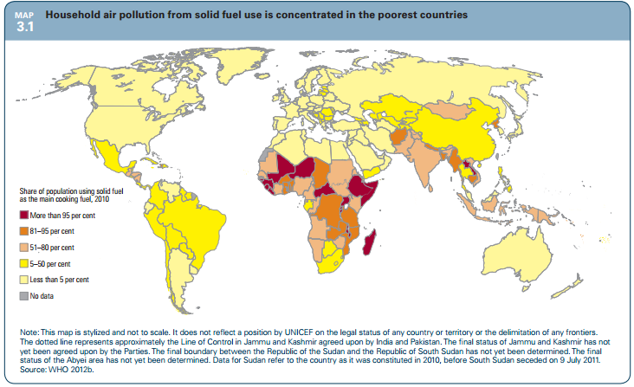
Indoor Biomass Smoke (BMS)
Notes:
Other home factors
Household air pollution, a well known risk factor for childhood pneumonia, places children
at particular risk for several reasons: their lungs
and immune systems are not fully developed,
they breathe more in proportion to their body
size and they often spend more time inside the
home.
11
Household air pollution in low-income countries
is due mainly to use of solid fuels (such as wood,
crop waste, animal dung and coal) for cooking
or heating in poorly ventilated open fires and
stoves. Today, around 3 billion people worldwide
use solid fuels as their main cooking fuel, and
the most recent estimates show that solid fuel use
contributed to nearly 2 million premature deaths
in 2004, nearly half of them due to childhood
pneumonia.
12
People in the poorest countries – particularly
South Asian and sub-Saharan African countries,
which have the most deaths due to pneumonia –
often use solid fuel (map 3.1). Within these countries it is likely that a larger share of people use
solid fuels in the poorest households or in rural
areas than in better-off households or urban
areas.
Overcrowded homes are also associated with
increased risk of childhood pneumonia
13
because
disease-causing pathogens can spread to more
people faster. Such is the case in slum environments, which typically have poor sanitation and other home risk factors that aid transmission.
Recent studies also suggest ambient particulate air pollution, often found in megacities,
may increase the risk of acute lower respiratory
infections.
14

Slide 11
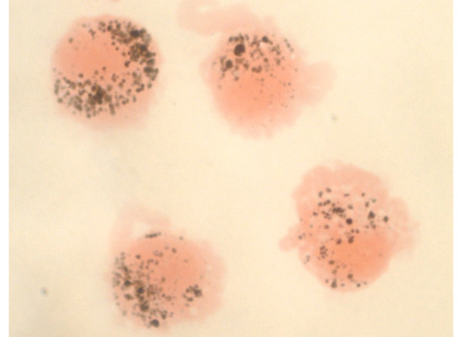
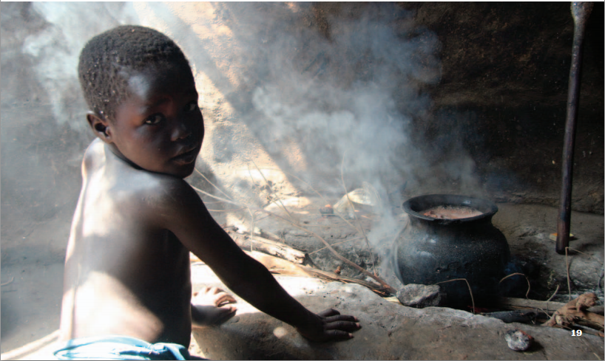
Indoor Biomass Smoke (BMS)
↑Pneumonia
↓FEV1
↓Macrophage phagocytosis
↑AMC

Slide 12
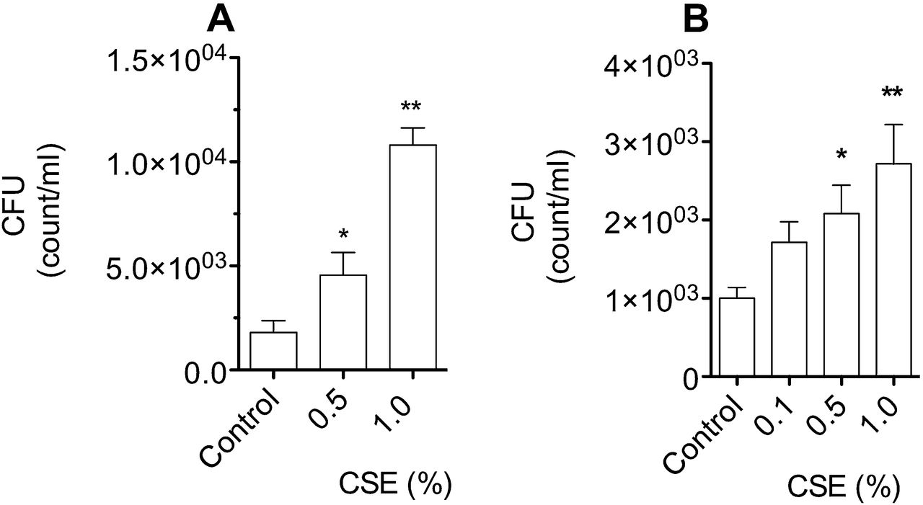

Effect of cigarette smoke extract (CSE) on the adhesion of Streptococcus Pneumoniae to; (A) BEAS2-B cells, and (B) human primary bronchial epithelial cells (HBEpC).
Grigg J et al. Thorax 2012;67:908-913
Copyright © BMJ Publishing Group Ltd & British Thoracic Society. All rights reserved.
Notes:
Effect of cigarette smoke extract (CSE) on the adhesion of Streptococcus Pneumoniae to; (A) BEAS2-B cells, and (B) human primary bronchial epithelial cells (HBEpC). CSE 1% increases adhesion to both cell types (*p<0.05, and **p<0.01 vs control, n≥5). Data are expressed as mean (SEM) and are representative of four separate experiments for BEAS2-B, and two separate experiments for primary bronchial cells. CFU, colony forming unit.

Slide 13
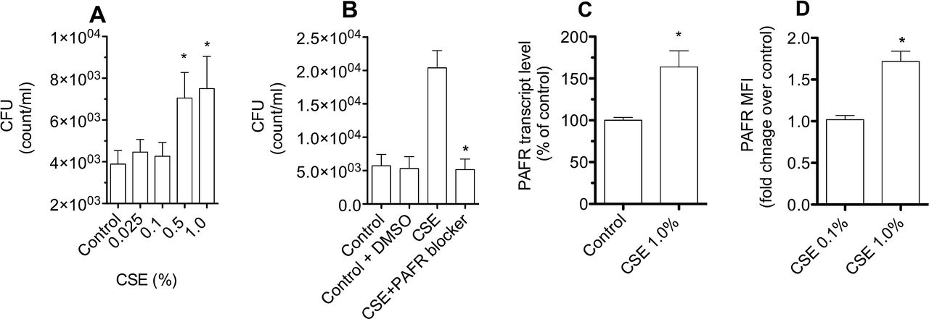
Effect of cigarette smokes extract (CSE) on A549 cells.
Grigg J et al. Thorax 2012;67:908-913
Copyright © BMJ Publishing Group Ltd & British Thoracic Society. All rights reserved.
Notes:
Effect of cigarette smokes extract (CSE) on A549 cells. (A) Incubation with CSE 0.5% and 1% increases Streptococcus pneumoniae colony-forming units (CFU), indicating increased adhesion (*p<0.05 vs medium control). Data are represented as mean and SEM (n=8, and n=6 respectively). (B) Coincubation with a platelet-activating factor receptor (PAFR) blocker (10 μM CV-3988) attenuates CSE-stimulated adhesion (*p<0.001 vs without PAFR blocker). Dimethyl sulfoxide (DMSO) at 1% does not affect adhesion. Data are represented as mean and SEM (n=8), and are representative of four separate experiments. (C) CSE 1% increases PAFR transcript level (*p<0.01 vs medium control). PAFR was assessed by quantitative real-time PCR and normalised for the housekeeping gene glyceraldehyde-3-phosphate dehydrogenase (GAPDH). Data are representative of two experiments with six replicates. (D) CSE 1% increases PAFR expression. Cells were immunostained with either mouse antihuman PAFR, or isotypic control and expression determined by flow cytometry. Data are described as fold change in median florescence intensity (MFI) over medium control, adjusted for the isotypic control. Data are expressed as mean (SEM) fold change, and are from four separate experiments (*p<0.01 vs control).

Slide 14
SHISHA SMOKING
Hookah, waterpipe, narghile
  Lower perception of harm
  Increasing popularity esp in Arabic-speaking countries
  Evidence of equivalent harms to cigarettes
  Increased pneumonia risk

Slide 15
Reducing Indoor Air Pollution
Indoor biomass cooking
  Alternative fuels
    Electricity, LPG, biogas, solar power
  Improved stoves
    ↑combustion, ↓emissions, ↓cook time
  Improved environment (ventilation)
  Behavioural (using dry fuel, avoidance)
Environmental tobacco smoke
  Anti-smoking advice
  Shisha education
COST
EFFECT

Slide 16
Summary
Pneumonia is a major killer
Effective interventions exist
Education can enhance delivery
Could help save 1 million under-5 lives/year

Slide 17
MCQ - 1
The following are pneumonia risk factors? (T/F)
A - Tobacco smoke exposure
B - Low birth weight
C - Measles vaccination
D - Poor hand hygiene
E - Premature birth

Slide 18
MCQ - 2
True or False – The following vaccines may directly protect against pneumonia
A - Measles
B - Haemophilus Influenzae type B (HiB)
C - Pertussis
D - Malaria vaccination
E - Pneumoccal conjugate vaccine

Slide 19
MCQ - 3
True or false – Harm from indoor Air Pollution may be reduced by:
A - Use of liquid petroleum gas
B - Burning wood fuel while damp
C - Improving ventilation in cooking areas
D - Keeping children away cooking areas
E - Using different stove designs

Slide 20
MCQ - 4
True or false – Shisha smoking is :
A - Uncommon in Arab speaking countries
B - Safer than cigarette smoking
C - A cause of increased pneumonia risk
D - Not addictive
E - Reducing in popularity

Slide 21
MCQ - 5
True or false – Tobacco smoke:
A - Increases epithelial PAF receptor expression
B - Enhances pneumococcal adhesion
C - Is safer if it is shisha tobacco
D - Is not a source of indoor air pollution
E - Is primarily a European problem

Slide 22
Answers
1 TTFTT
2 FTFFT
3 TFTTT
4 FFTFF
5 TTFFF

