Slide 1
Cough and Wheeze
Respiratory Top Tips
CHINEDU NWOKORO
8th June 2017

Slide 2
Outline
Chronic Cough
Wheezy infants and preschoolers (when is it asthma?)
What tests are useful?
Who and how to investigate?
A smattering of cases
I will not talk about management of established tertiary respiratory illness.
I will not talk about bronchiolitis

Slide 3
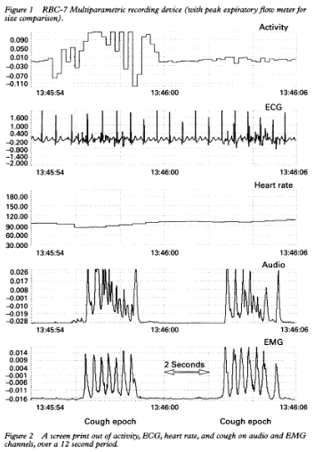
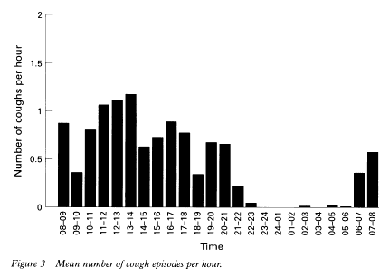
What is a normal cough frequency?
Mean 11 cough epochs / 24 hours with no preceding RTI (range 1-34)
Munyard P, Bush A Arch Dis Child 1996; 7:531-4

Slide 4
Chronic cough - Respiratory infections
What is normal ?
6-10 RTIs / year (age 0-4 yrs)
2.5-5 RTI / year (age 10-14 yrs)
Most resolve without treatment
Monto AS Epidemiol Rev 1994; 16(2): 351-73 (review article)

Slide 5
What is a chronic cough?
Adults > 8 weeks (BTS 2006)
Children no universal definition - range >3-12 weeks
Primary care children 80% with chronic cough have 5 or more consultations
Marchant JM et al Chest 2008;134:303-9
Morrice AH Eur Resp J 2004; 24:481-492
Chang AB J Asthma 2001; 38: 299-309
Duration | Nomenclature
<3 weeks | Acute Cough
3-8 weeks | Prolonged (Subacute) Cough
>8 weeks | Chronic Cough (Aus/USA > 4 weeks)

Slide 6
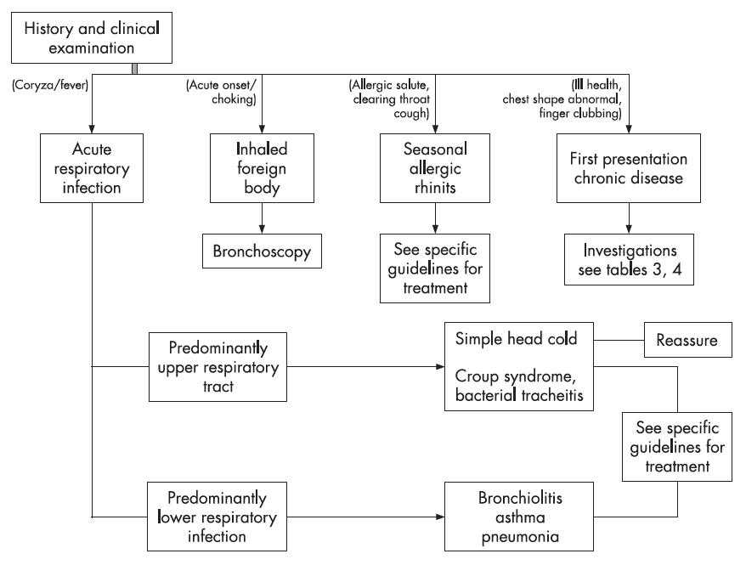
BTS ‘08 – Acute Cough

Slide 7
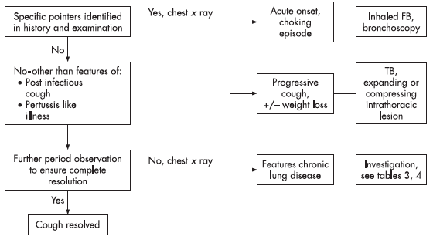
BTS ‘08 – Subacute Cough

Slide 8
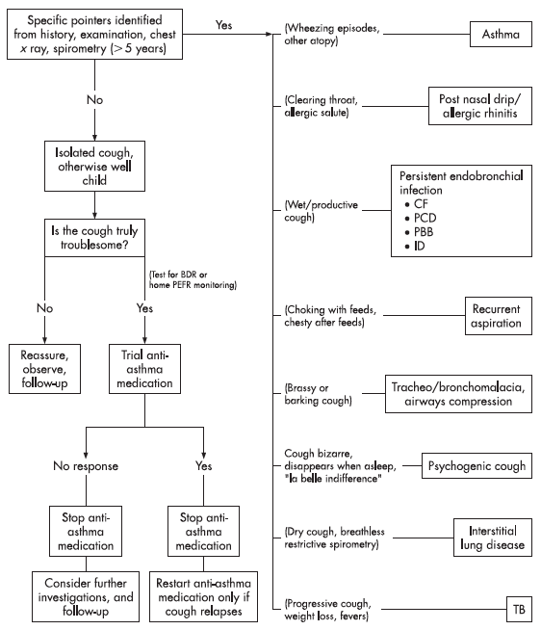
BTS ‘08 – Chronic Cough
Dry cough
Atopy
Harrison Sulcus
Wheeze
FH
Exercise/Noct sx
Brassy/Barking
Hx of TOFistula
Lymphadenopathy
No clinical signs
Distractibility
Quiet nights
“Abnormal” cough
Rhinitis
Throat clearing
Hayfever
Dry cough
Clubbing
Breathlessness
Clubbing
Restrictive spiro
Wet cough
Poor growth
Steatorrhoea
Clubbing
Other infxns
Progressive
Weight loss
Fevers
Night sweats
Lymphadenopathy
Reflux
Exercise/noct sx
Dysphagia
Food aversion

Slide 9
Chronic Cough – Other factors
Take a good history!
Normal viral RTI and GI illness?
Are there symptom free episodes?
Exposure to other children? (nursery/siblings)
Atopy? pets? HDM? Hay Fever?
Cigarette smoke exposure
Damp - fungal spores
(Ab)Normal birth history / neonatal respiratory difficulty?
Relevant family history

Slide 10
Chronic Cough – Other factors (2)
Take a good history (part 2) !
How and when did cough start? (NNU/ v.acute/ RTI)
What is nature of the cough? (wet/honk/paroxysmal)
Is cough an isolated symptom? (wheeze/SOB/fever)
What triggers cough? ( cold air/exercise/feeding/lying down)
Coughing during sleep? (not much with habit cough)
What treatment given and what effect?
Antibiotics (which? How long? Taken properly?)
Inhalers (which? Doses? Technique?)

Slide 11
Chronic cough
What’s not normal? (Red Flags)
Persistent wet cough – at least 4 weeks
No symptom free intervals
Poor weight gain and growth
Persistent or focal signs in the chest / clubbing
Other infections at other sites (ear discharge)
Unusual organisms
Abnormal CXR
How to focus down?

Slide 12
What type of cough?
Specific – predominantly wet cough, abn signs
aspiration,
IFB,
bronchiectasis, immune deficiency,
haemoptysis, UACS etc.
Non-specific – predominantly dry cough
Asthma
Habit
Pertussis/mycoplasma
UACS

Slide 13
Focus on Pertussis
Classic (severe) pertussis: ≥ 21 days paroxysmal cough + associated whoops or post-tussive vomiting,
Incubation period 7-10 days (coryzal stage)
Coryzal prodrome, marked lymphocytosis.
An irritating cough gradually becomes outbursts of coughing (paroxysmal), usually within 1-2 weeks
Coughing spasms may be followed by vomiting.
Not all have characteristic 'whoop', partic. young infants. Often lasts ≥ 2-3 months (“100 day cough")
Convalescent phase may last weeks or months.

Slide 14
Whooping cough B. pertussis
Vaccination → milder, non-classic disease
Whoop is seen in only 6% of such cases
The illness is characterized by a non-specific, prolonged cough, lasting several weeks to months
Under-diagnosed in adults and adolescents, who may be reservoirs for infection of unvaccinated infants.
Up to 80% of infections in unvaccinated children were acquired from siblings and parents (n.b. vacc in utero)

Slide 15
Chronic cough – post infection
European questionnaire:
12.7% 7-11yr olds had cough lasting >3/12
18 Oxfordshire General practices
179 children 5-16yrs cough >21 days
37% Pertussis (CD 118d), Mycoplasma 13% (CD 39d)
Wang K Paed J Infect Dis 2011;30:1047-1051
Harnden et Al BMJ 2006;33;174-7

Slide 16
Chronic cough – Persistent bacterial bronchitis
100 children Median age 2.8 years
Cough median duration 6/12
CXR +/-spirometry
All standard bloods and sweat test
Mycoplasma & B.pertussis serology
Bronch/BAL
CT+/- pH study in >50%
Marchant Thorax 2006 Australia

Slide 17
Chronic Cough - Persistent bacterial bronchitis
‘Specific cough’ 69
Persistent bacterial bronchitis 45
Bronchiectasis 6
Asthma 4
Eosinophilic bronchitis 4
Aspiration 5
Mycoplasma 2
B.Pertussis 1
TB 1
Bronchiolitis obliterans 1
‘Non-specific cough’ 31
Natural resolution 24
Upper airway CS 3
Gastro-Oe reflux 3
Habit cough 1
20/29 with dry cough resolved spontaneously
14/71 with wet cough resolved spontaneously
Most important pointers to ‘specific diagnosis’: wet cough – abnormal chest findings – CXR abnormalities

Slide 18
Persistent bacterial bronchitis: outcome
81 patients (Sheffield)
Median age 3.7 years
Symptoms start <2 years in 59%
Duration >1 year in 60%
Persistent wet cough diagnosed and responded to treatment for PBB (prolonged high dose augmentin)
Everard Thorax 2007

Slide 19
Persistent bacterial bronchitis – RFs
95% moist cough on request
48% wheeze 43% SOB
31/81 had smoker in house
30% CXR abnl
4/14 Bronchiectasis on CT
Micro → Haemophilus > Strep. Pneumonia
31/81 final diagnosis of asthma
41 asymptomatic after 4 weeks antibiotics
Treatment plan
4 weeks abx - if better - continue for 4-6 weeks

Slide 20
Bronchiectasis with cough after Rx (x20)
106 / 144 children, aged 10–199 months had CT scan evidence of bronchiectasis (BE).
Antibiotic data available for 129. Among the 105 children with persistent cough despite at least 4 weeks of antibiotics, 88 (83.8%) had bronchiectasis.
24 children whose cough resolved after antibiotics, only six (25%) had BE.
Being Indigenous was also independently associated with radiographic evidence of bronchiectasis
Goyal V Arch Dis Child online Feb 2014

Slide 21
Chronic cough – older children
40 children:mean age 7.8 yrs chronic cough > 8/52
G-Oe reflux 27%
Allergy 22.5%
Asthma 12.5%
Infection 5%
Aspiration 2.5%
Multiple causes 20%
All tests normal 10%
Reflux + allergy + asthma = >80%
11 of allergic children had UACS = post nasal drip
Khoshoo Chest 2009

Slide 22
PBB and airway malacia
Persistent wet cough in 0-3 yrs age group
= 30% tracheo or laryngomalacia. Zgherea
<5yrs 74% tracheo or laryngomalacia Kompare
Purulent bronchitis: H.flu, S.pneumo, M.catarrhalis, S.aureus often >1 organism
Zgherea D Pediatrics 2012;129: 1-6
Kompare M J Pediatr 2012;160; 88-92

Slide 23
PBB and bronchiectasis???
Vicious cycle hypothesis –
PBB may lead onto ‘Non CF’ bronchiectasis
H. Influenza
S.Pneumococcus
M.Catarrhalis
S. aureus
(recurrent) viral infection
↓
2nd^{ary} bacterial infection
Airway obstruction
Bronchial wall inflammation
Mucus hyper-secretion

Slide 24
Chronic cough and asthma
Cough variant asthma – does it exist?
Chronic, non-productive, cough alone
even night cough……..in a non-atopic child
without wheeze or exercise related symptoms:
is highly unlikely to be due to asthma !
Always consider OSA as a cause of night cough
- OSA – commonest cause of night sweats in UK children
Ninian TK Russell G Arch Dis Child 1995; 73: 403-407
Marguet C Am J Resp Crit Care Med 1999; 159; 1533-1540

Slide 25
Chronic Cough – UACS – post nasal drip
128 children chronic cough seen by ENT
116 nasal disorders
UACS diagnosed in 92 (72%)
allergic rhinitis 76; rhino-sinusitis 39;
adenoidal hypertrophy 54; (some overlap)
Other nasal problem 18% (mostly other rhinitis)
No cause found 10%
Purulent secretions on naso-pharyngoscopy in 91/128
High success rate 90/92 for treating cough by addressing cause of UACS.

Slide 26
Upper airway cough syndrome
Nasal secretions & Cough have common aetiology - -
- cause and effect not convincing
No specific diagnostic features
Response to treatment (adults) with (some of)
Decongestants
Antihistamines
Nasal steroids
Allergen avoidance

Slide 27
Chronic cough and G-Oe reflux
40% adults with chronic cough have GORD
In children:
Cause and effect difficult to prove
Cough ⬄ reflux? Reflux vs Reflex theory?
No studies have demonstrated symptom improvement with medical or surgical treatment
Asthma and acid blockade experience – poorly controlled asthma not helped by empirical reflux meds even in those with proven reflux
Trial of therapy remains common practice (PPI, H2 antagonist, Prokinetic erythromycin, domperidone???)

Slide 28
Chronic cough- Recurrent aspiration
Bulbar problems, laryngeal abn, H-type TOF, GOR
Predominantly right sided CXR signs
Ba swallow/pH-Impedance study/SLT +/- ENT revie w
Bronchoscopy - oedematous airways / minor carinae
Bronchial lavage - fat laden alveolar macrophages
Isotope scan (milk scan)
Bulbar EMG, MRI if indicated
Case AO: diagnosis of brainstem tumour from SLT Ix of chronic feed-related cough

Slide 29
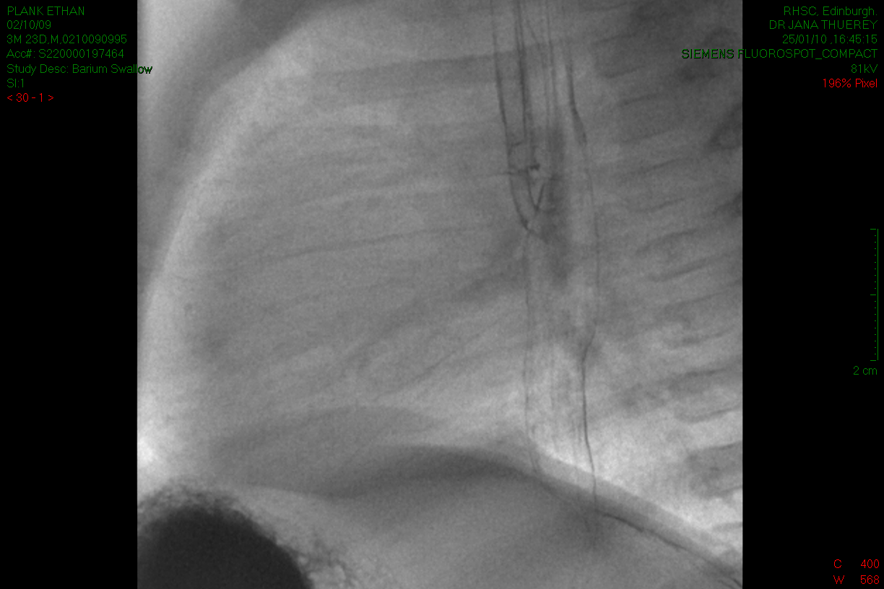
Chronic cough - recurrent aspiration
H-ToF: coughing, choking with feeds, noisy breathing, abdominal distension (Post-repair TOF cough, residual GOR)

Slide 30
Chronic cough and CF
Neonatal Screening: IRT + DNA (4 mutations)
– Immunoreactive Trypsin as screening test
5% false negative results from CF NBS programme
- Not all ‘mild’ / ’atypical’ (SPIDs) / CFTR variants
Don’t forget the sweat test
Sweat chloride >25 mmol/l – Abnormal - needs further testing

Slide 31
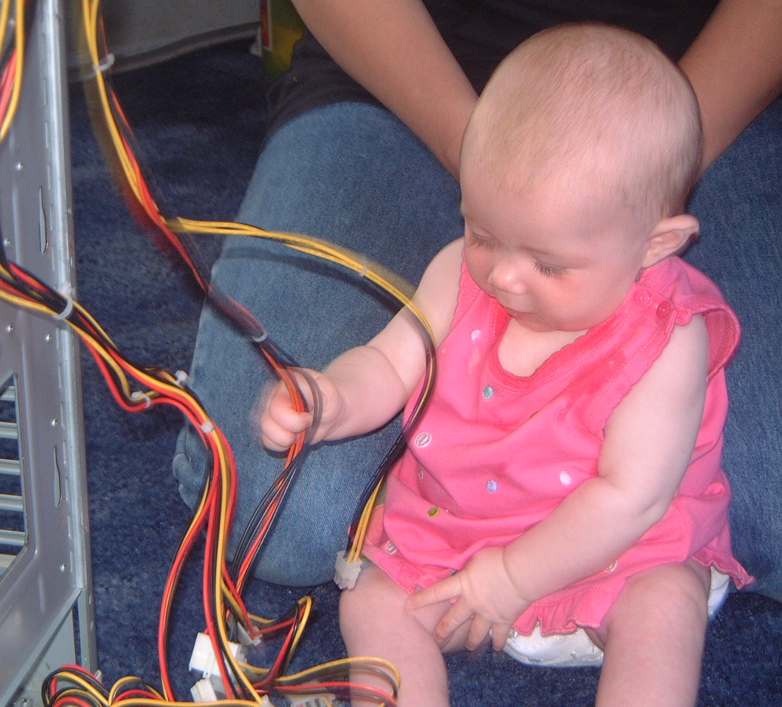
Chronic cough and CF – A Case
TC – 13 years old, chronic “asthma”
Born like:
Presents like:
Cough
Wheeze
Exercise limitation
Reduced FEV1
Admitted to local with “LRTI”

Slide 32
Chronic cough and CF – A Case
Closer investigation
Cachectic and stunted (wt 30kg @ 13y)
Clubbed, Lifelong steatorrhoea, Wet cough, sputum
Exercise capacity 30y (when well)
FEV1 33%, nocturnal hypoxaemia
Sweat [Cl⁻] = 95mmol/L, Stool elastase = <200mcg/g
x2 CF genes → Dx confirmed
A lifetime of mismanagement
What happened???

Slide 33
Chronic cough and CF – A Case
Engaged with treatment
Started on CFTR modifier
6 months of treatment
30kg
FEV1 33%
Clubbed
Invalided
60kg
FEV1 99%
No clubbing
Sporty++
Take a good history!!!

Slide 34
Chronic cough - and airway abnormality
Tracheo – broncho – malacia (ToF-cough)
Airway collapse during expiration /coughing
Impaired airway clearance
30% of children with persistent wet cough
have tracheomalacia (0-3 yrs)
Airway compression / collapse (lymphadenopathy?)
Other congenital abnormality (vascular ring)
Zgherea D Paediatrics 2012

Slide 35
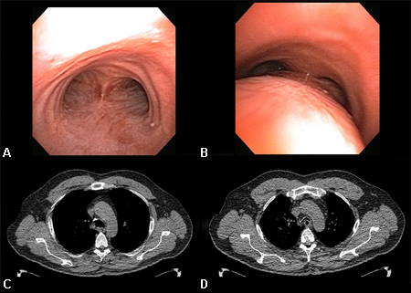
Chronic cough & tracheomalacia

Slide 36
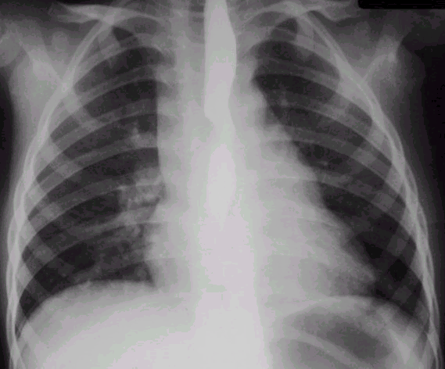
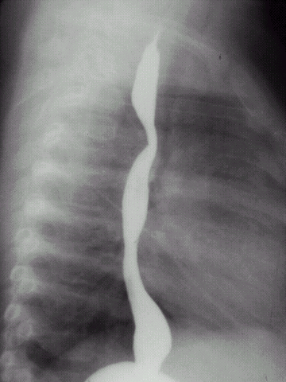
Vascular ring causing chronic cough

Slide 37
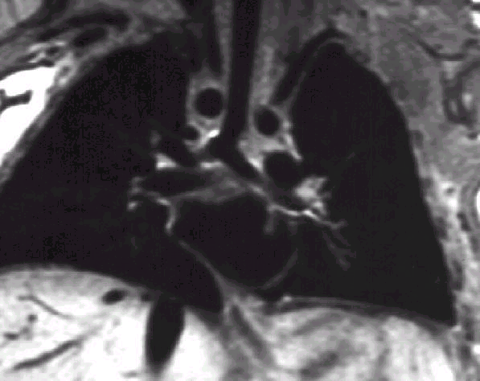
Vascular ring causing chronic cough

Slide 38
Habit cough – psychogenic cough
Honking noise : theatrical
Predominantly daytime but not exclusively
Up to several times per minute
May last for months ? Following infective trigger
Exhausted / off school / headaches / abdominal pain
Magical cure! – reinforced suggestion
‘The cough and the bedsheet’
Breathing control / brief session suggestion therapy
– convince the child he doesn’t need to cough!
Cohlan SQ, Stone SM Pediatrics Vol. 74 No. 1 July 1, 1984 p. 11 -15
Weinberger M Lung 190: 45-53 2012

Slide 39
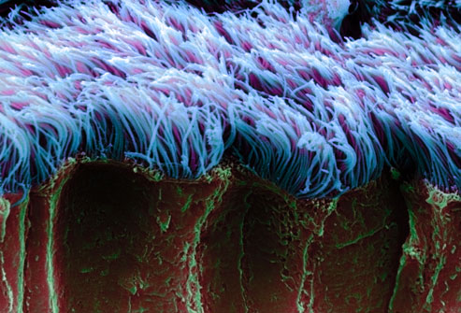
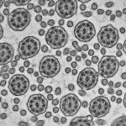
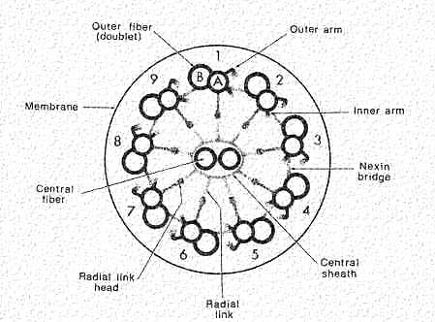
Primary Ciliary Dyskinesia

Slide 40
Primary Ciliary Dyskinesia - features
Neonatal breathing problems –75%
Situs inversus / dextrocardia 50%
Mucousy (nasal) babies - difficult to feed
Cough – leading to bronchiectasis in adulthood
Hearing problems (? Avoid grommets)
Infertility Males 50% - Females tubal pregnancy

Slide 41
Persistent cough – PCD diagnosis
Nasal Nitric oxide: low in PCD (<105ppb)
Nasal brushings : for cilia motility
for EM ultrastucture
PCD gene testing: >32 genes implicated
Bush A, Arch Dis Child 2007 vol 92 1136-1140

Slide 42
Pulmonary TB in children
Symptoms
cough, fever, night sweats, fatigue, malaise, anorexia, weight loss
Children often asymptomatic
Investigations
Rarely produce sputum → GW/IS, TST, IGRA
Red flags:
‘Acute’ CXR/effusion in relatively well child
Older children w. effusion (Whitechapel at least!)
Exposure history (case: local child empyema ref)

Slide 43
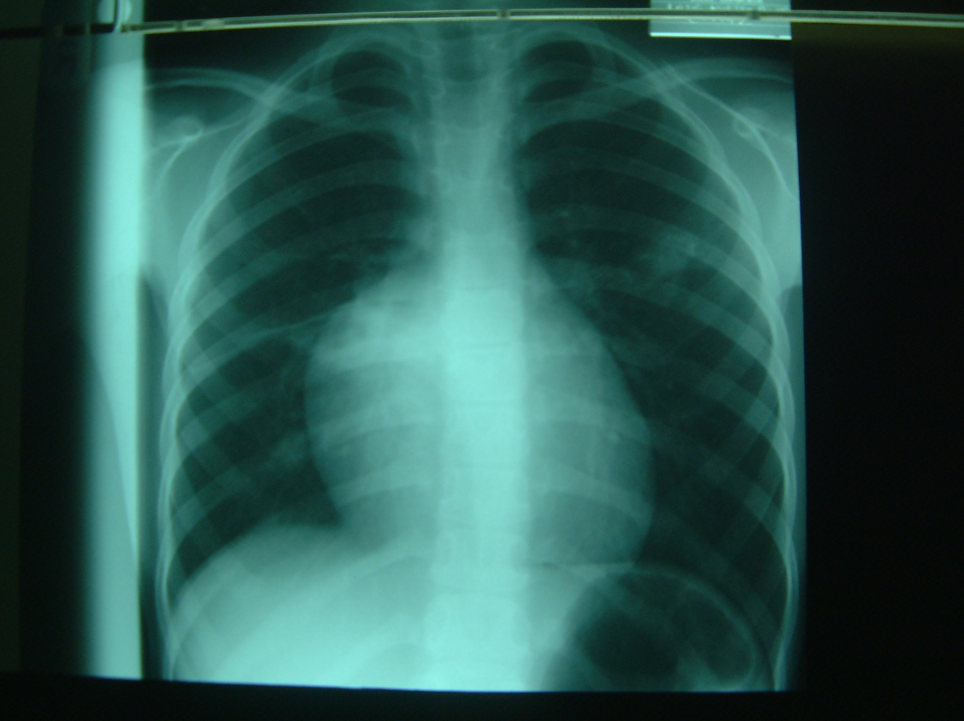
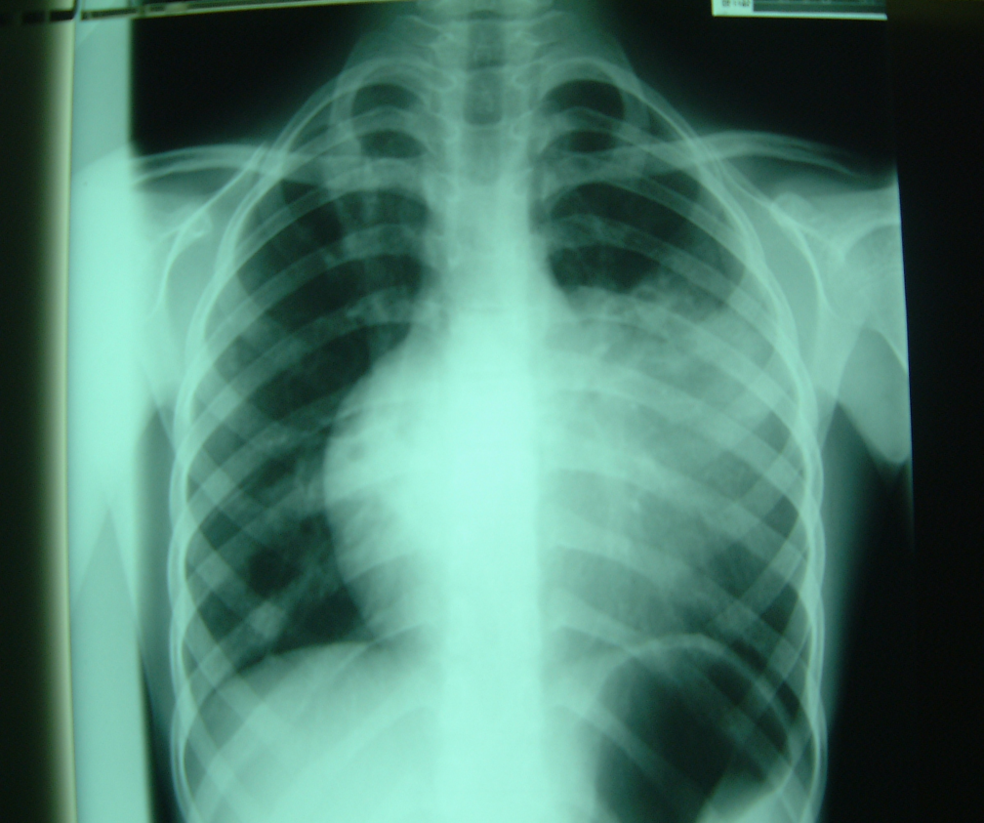
Never forget TB

Slide 44
So what do you do?
No red flags, intermittent symptoms, dry cough, CXR (N):
- watch and wait
Persistent symptoms, wet cough, CXR abnormal?
- 4 week course PO abx (aug/clari)
- If not-improved/improved but relapse
- Investigate further:

Slide 45
Chronic cough – Ix
Chang AB et al Pediatrics 2013; 131:1756-83

Slide 46
Chronic cough – Ix - specifics
Cough swab/sputum
Immune screen
Sweat test, nasal NO/brushings
Imaging (CXR, Contrast swallow, CT chest)
SLT (VF?), ENT (MLB?)
Impedance/pH study?
Bronchoscopy
Spirometry + bronchodilator response
Exercise testing
(Psychology)

Slide 47
General Interventions
Ensure fully immunised (incl flu), vitamin D replete
Consider antibiotic prophylaxis (azithro MWF 10mg/kg)
Lifestyle (exercise, ETS, damp, allergen, ?physio req)
Nutrition (monitor growth, adequate hydration)
Nutrition; Monitor growth – increase calories
Monitoring (depends on cause/severity)
Symptoms, spirometry, anthropometry, saturations
Cough swab/sputum (every clinic)
Consider annual CXR
Normal immunity can change… (CVID)

Slide 48
Key references
BTS Guideline
Recommendations for the assessment and management of cough in children
M Shields, A Bush et al for BTS 2007/8
Chang AB et al
A cough algorithm for chronic cough in children
Pediatrics 2013: 131: e1576 – 83
Shields MD et al
The difficult coughing child
Cough 2013:9;

Slide 49
Top tips to take-away
Cough
Early onset wet cough: consider the anatomy
Chronic wet cough: treat – investigate if not better
Cough alone: unlikely to be asthma

Slide 50
Thank You – Questions?

