Slide 1
Morbidity and Mortality in <5
Dr Chinedu Nwokoro
MB BChir MRCPCH

Slide 2
Synopsis
Sources of Information
Global targets, global trends
General principles of <5 M and M
Maternal morbidity
Neonatal morbidity
Key Conditions, Key interventions
Notes:
<5 mortality reducing 1990-2010 88/1000 live births to 57 (35%)
Incr rate of decline 2.1% per year 1990-2010 to 2.6% pa 2005-2010
50% child deaths occur in WHO African Region rate of decline incr from 1.8-2.8

Slide 3
Child Mortality Definitions
Mortality among young children can be subdivided by age group
Category | Includes deaths that occur:
Neonatal mortality | During the first 28 days of life
Post-neonatal mortality | At ages 1 to 11 months
Infant mortality | Between birth and exact age 1
Child mortality | At ages 1 to 4 years
Under-five mortality | Between birth and exact age 5

Slide 4
Sources of Information
Inter-agency Group for Child Mortality Estimation (IGME)
Source | Pros/Cons
Vital registration | Best source if systems adequate, resource dependent
Sample registration | Representative sample, expensive, complex (COD info)
Demographic Surveillance Sites | Small, localised populations → spec interventions (<200k)
Population censuses | Expensive, infrequent (10y), no sampling error
Household surveys | Main source U5MR data
Notes:
Vital Registration (births + deaths, contemporaneous, misses deaths, systems dependent, 50 countries only good enough)
Sample Reg (China, Japan, cause of death info)
Household surveys (frequent cf census, less expensive cf vital reg, wide range info, main source of U5MR data)

Slide 5
Current Status
6.9m under-5s die every year
13 children every minute worldwide
 | Under-Five Population | Live Births | Under-Five Deaths | Under-Five Mortality Rate | Annual Rate of Reduction | Annual Rate of Reduction
 | 2011 | 2011 | 2011 | 2011 | (1990-2000) | (2000-2011)
Sudan | 5,091,941 | 1,114,001 | 94,650 | 86 | 1.70% | 1.70%
Egypt | 9,092,189 | 1,885,631 | 39,593 | 21 | 6.60% | 6.80%
U.K. | 3,858,141 | 761,070 | 4,091 | 5 | 3.3% | 2.3%
Nigeria | 27,195,491 | 6,457,908 | 755,685 | 124 | 1.3% | 3.8%

Slide 6
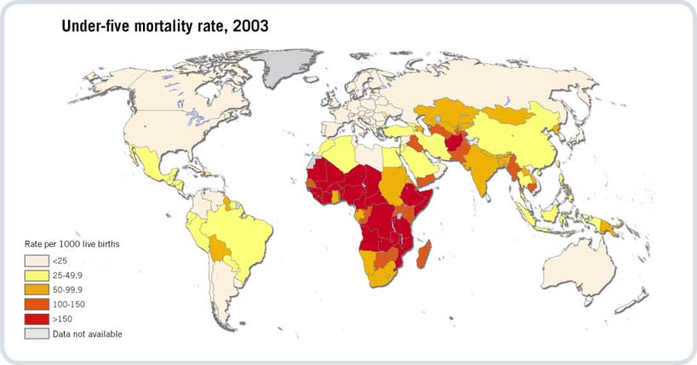
Global U5MR – WHO 2005

Slide 7
U5MR Targets
1990 U5MR = 87/1000
MDG 4 - 2/3 reduction by 2015
2011 U5MR = 51/1000
To Achieve MDG4 (29/1000)
Further reduction of 22 deaths/1000 per year
AARD increase from 3.2% to 4.3% (globally)
Focus on subsaharan Africa
Congo, China, India, Nigeria, Pakistan

Slide 8
Absolute Trends in U5MR
Level & Trends in Child Mortality. Report 2011. Estimates Developed by the UN Inter-agency Group for Child Mortality Estimation (UNICEF, WHO, World Bank, UN DESA, UNPD).

Slide 9
Spotlight on Sudan - 1

Slide 10
Spotlight on Sudan - 2
Malaria, diarrhoea, pneumonia improving
Neonatal deaths no better

Slide 11
Spotlight on Egypt - 1

Slide 12
Spotlight on Egypt - 2
Pneumonia and
Diarrhoea improving, but...
Neonatal deaths more significant

Slide 13
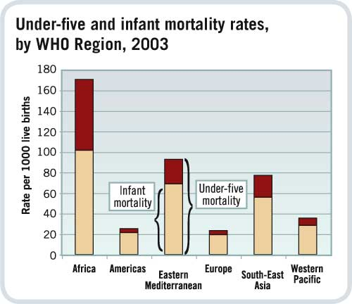
Infant Mortality
EMR had 2nd top U5MR
Infant + neonatal mortality

Slide 14
Maternal Mortality
Maternal health and nutrition
Maternal education
Neonatal/ perinatal care

Slide 15
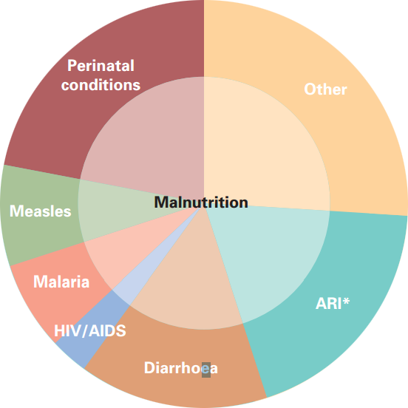
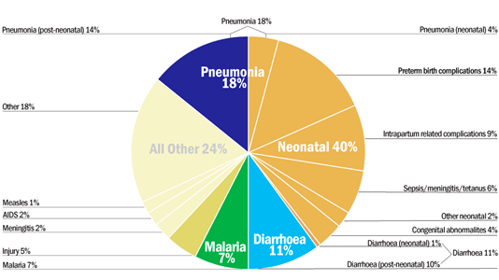
Key Conditions - Global
Pneumonia – 18%
Prematurity – 14%
Diarrhoea – 11%
Intrapartum – 9%
Malaria – 7%
(Malnutrition – 1/3)
Notes:
Measles dramatically reduced in 10 years from 7% to 1%
Malnutrition accounts for 1/3 and contributes to all deaths
2/3 are due to infectious diseases
Difficult to asccertain primary cause if multiple diseases
Pneumonia – 18%
Prematurity – 14%
Diarrhoea – 11%
Intrapartum – 9%
Malaria – 7%
(Malnutrition – 1/3)

Slide 16
Interventions
Low Cost Public Health Interventions
Vaccination (GAVI Alliance)
Measles vaccination (85% of 12-23m)
2000-2010 – 74% reduction in measles deaths (20% of reduction in childhood deaths).
20% deaths vaccine preventable.
Sanitation
Insecticide and Mosquito nets
Nutrition and Clean water
Notes:
Maternity care
HIV
Malaria vaccination

Slide 17
HIV
2010 Incidence 2.7m (down 15% from 2001)
SSA still has majority of incident cases.
2010 Prevalence rising (increasing ART rx)
Contribution to deaths may be underestimated
Diarrhoea
Pneumonia
TB

Slide 18
Tuberculosis
Directly observed therapy to prevent spread
Antituberculous chemotherapy
HIV prevention and treatment
BCG vaccination

Slide 19
Malaria
Insecticide-impregnated nets
Residual indoor spraying
Antimalarial treatment
Covering of still water sources
A vaccine?

Slide 20
Summary
U5MR is declining but MDG4 will not be met
Rates vary between countries
Infant and Neonatal mortality significant
Infectious disease and malnutrition are key
Effective interventions are simple (MDG)
Disease specific interventions play a role
Infant mortality difficult to change

Slide 21
MCQ - 1
Concerning Under 5 mortality rate, are the following statements true or false?
A does not include deaths of premature babies
B is a measure of the probability that a live born child will survive to their 5th birthday
C neonatal mortality is improving faster than under-5 mortality
D millennium development goal 4 is likely to be achieved
E is mainly due to congenital conditions

Slide 22
MCQ - 2
Concerning Under 5 mortality data, which statements are true?
A National census data is the most useful source
B Is of equal quality from all countries
C Vital registration data may underestimate mortality
D National resources affect data quality
E Can be used to direct public health interventions

Slide 23
MCQ - 3
The following factors affect infant mortality
A Maternal nutrition
B Maternal education
C Perinatal care
D Vaccination coverage
E HIV prevalence

Slide 24
MCQ - 4
Place these conditions in descending order of global importance (1 = causes most deaths, 5 = causes least deaths)
A Respiratory Infection
B Malaria
C Diarrhoea
D Prematurity complications
E Birth complications

Slide 25
MCQ - 5
The Inter-agency Group for Child Mortality Estimation (IGME) is a collaboration between which of the following organisations.
A UNICEF
B United Nations Population Division
C World Bank
D UNESCO
E The World Health Organisation

Slide 26
Answers
1 FTFFF
2 FFTTT
3 TTTTT
4 15324
5 TTTFT

